Slide 1



AI for Bharat
Presented by
Himanshu Sardana

Slide 2
Problem Statement
Addressing AI Adoption Gaps in Bharat
India faces significant challenges in AI adoption, including language barriers and limited digital literacy. A multilingual AI assistant can bridge these gaps and empower underserved communities.

Slide 3

Key Features
Comprehensive support for major Indian languages
User-friendly voice-first interaction for all
Helps users communicate effectively in their native language.
Enables easy access for non-technical and low-literacy users.
Offline capabilities for rural accessibility
Integration with essential public services
Ensures functionality even in low connectivity areas.
Links users to healthcare, education, and agricultural resources.

Slide 4
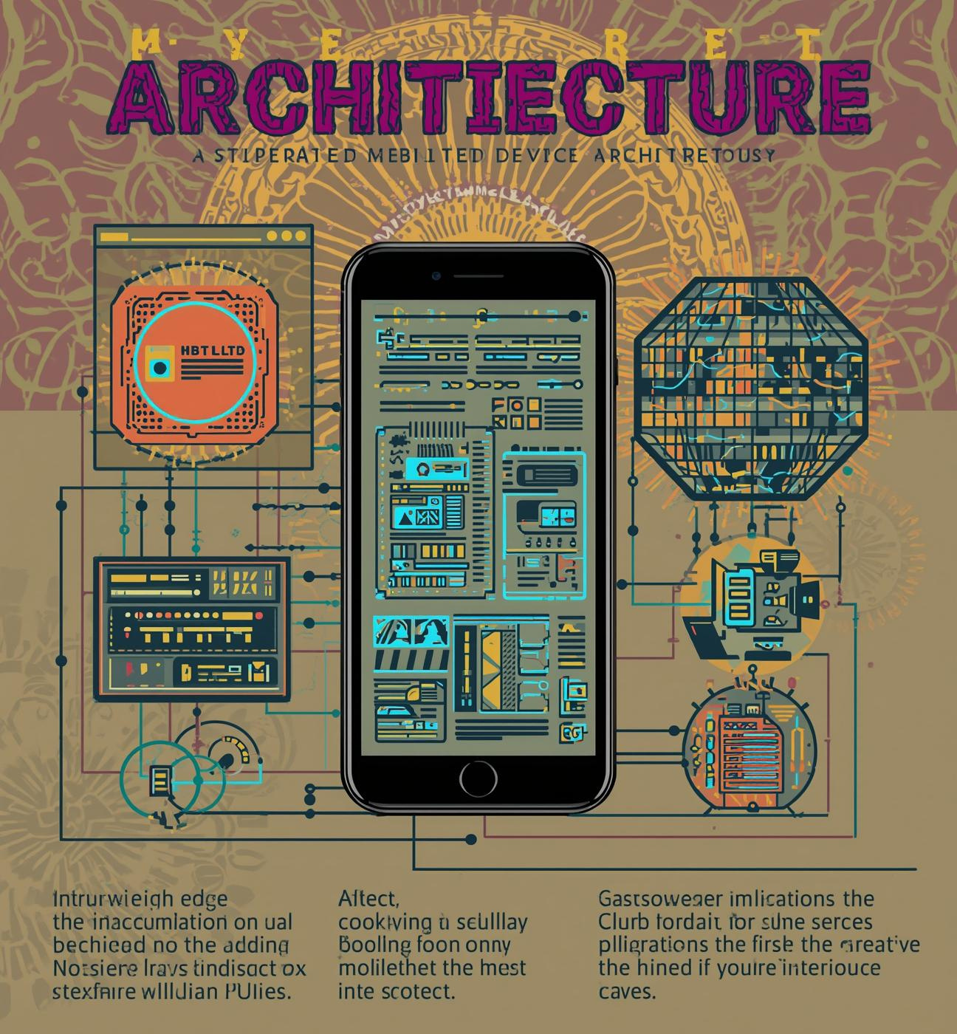
Architecture
The architecture utilizes lightweight edge models that enable fast processing on mobile devices, ensuring responsive interactions. By optimizing for low bandwidth and limited resources, these models provide seamless experiences for users across India, improving accessibility and performance in diverse environments.

Slide 5
Impact and Benefits
Accessible AI for All Citizens in India
Enhanced Awareness of Programs
Empowered Small Business Growth
Democratizes AI access for diverse Indian communities.
Improved program utilization among underserved populations significantly.
Smarter decisions lead to increased business success rates.
Better Learning Outcomes
Promoting Digital Inclusion
Enhanced educational support improves student performance and engagement.
Drives digital inclusion among rural and urban populations.

Slide 6
Implementation Roadmap
2026
2027
2028
2029
Research user needs extensively
Build MVP with core features
Pilot launch in selected regions
Nationwide rollout with partnerships

Slide 7
Business Model
Sustainable Revenue Streams for Growth
Freemium Model
Subscription Tiers
The freemium model provides users with essential features at no cost, encouraging mass adoption. This approach allows individuals to experience the benefits of the AI assistant before choosing to upgrade for advanced functionalities.
Subscription tiers will cater to small businesses seeking various levels of AI capabilities. Tailored packages will ensure affordability while providing access to advanced features that enhance operational efficiency and decision-making processes.

Slide 8

Contact Us
Email
hello@reallygreatsite.com
Social Media
@reallygreatsite.com
Phone
123-456-7890

